Slide 1
CS162 Operating Systems and Systems Programming Lecture 7 Synchronization 1: Concurrency, Mutual Exclusion, and Atomic Operations
February 6th, 2023
Prof. John Kubiatowicz
http://cs162.eecs.Berkeley.edu

Slide 2
Recall: Use of Threads
Version of program with Threads (loose syntax):
main() {
ThreadFork(ComputePI, “pi.txt” ));
ThreadFork(PrintClassList, “classlist.txt”));
}
What does ThreadFork() do?
Start independent thread running given procedure
What is the behavior here?
Now, you would actually see the class list
This should behave as if there are two separate CPUs
CPU1
CPU2
CPU1
CPU2
CPU1
CPU2
Time

Slide 3
Recall: the Dispatch Loop
Conceptually, the scheduling loop of the operating system looks as follows:
Loop {
RunThread(); // Needs to return to loop every now and then!
ChooseNextThread();
SaveStateOfCPU(curTCB);
LoadStateOfCPU(newTCB);
}
This is an infinite loop
One could argue that this is all that the OS does
Should we ever exit this loop???
When would that be?
Notes:
Emergency crash of operating system called “panic()”

Slide 4
Running a thread
Consider first portion: RunThread()
How do I run a thread?
Load its state (registers, PC, stack pointer) into CPU
Load environment (virtual memory space, etc)
Jump to the PC
Note: We give control of processor/core to user code!!
OS is not running because user code is running
How does the OS get control back?
Internal events: thread returns control voluntarily
External events: thread gets preempted
Notes:
OS’s have almost human characteristics – unpredictable, hard to understand, …
Different things share the same CPU – one thread, then another
Similar to schizophrenia, like the movie Sybil, one body shared by several people, say we start with Dave Patterson
Threads are like the personalities of the CPU. First one thread/personality uses the CPU, then another,…

Slide 5
Internal Events
Blocking on I/O
The act of requesting I/O implicitly yields the CPU
Waiting on a “signal” from other thread
Thread asks to wait and thus yields the CPU
Thread executes a yield()
Thread volunteers to give up CPU
computePI() {
while(TRUE) {
ComputeNextDigit();
yield();
}
}
Notes:
Yield is for really nice people – Ever see two people at the supermarket checkout line? You first, no you first, …

Slide 6
Stack for Yielding Thread
User-Level Stack
ComputePI
yield
Trap to OS
kernel_yield
Stack growth
Kernel-Level Stack
run_new_thread
switch
How do we run a new thread?
run_new_thread() {
newThread = PickNewThread();
switch(curThread, newThread);
ThreadHouseKeeping(); /* Do any cleanup */
}
How does dispatcher switch to a new thread?
Save anything next thread may trash: PC, regs, stack pointer
Maintain isolation for each thread

Slide 7
Stacks for Yield with Multiple Threads
Consider the following code blocks:
proc A() {
B();
}
proc B() {
while(TRUE) {
yield();
}
}
Suppose we have 2 threads:
Threads S and T
Assume that both have been running for a while
Thread S
Thread T
A
A
B(while)
B(while)
Stack growth
yield
yield
kernel_yield
kernel_yield
run_new_thread
run_new_thread
switch
switch
Thread S's switch
returns to Thread T
Thread T's switch
returns to Thread S

Slide 8
Saving/Restoring state (often called “Context Switch)
Switch(tCur,tNew) {
/* Unload old thread */
TCB[tCur].regs.r7 = CPU.r7;
…
TCB[tCur].regs.r0 = CPU.r0;
TCB[tCur].regs.sp = CPU.sp;
TCB[tCur].regs.retpc = CPU.retpc; /*return addr*/
/* Load and execute new thread */
CPU.r7 = TCB[tNew].regs.r7;
…
CPU.r0 = TCB[tNew].regs.r0;
CPU.sp = TCB[tNew].regs.sp;
CPU.retpc = TCB[tNew].regs.retpc;
return; /* Return to CPU.retpc */
}

Slide 9
Switch Details (continued)
What if you make a mistake in implementing switch?
Suppose you forget to save/restore register 32
Get intermittent failures depending on when context switch occurred and whether new thread uses register 32
System will give wrong result without warning
Can you devise an exhaustive test to test switch code?
No! Too many combinations and inter-leavings
Cautionary tale:
For speed, Topaz kernel saved one instruction in switch()
Carefully documented! Only works as long as kernel size < 1MB
What happened?
Time passed, People forgot
Later, they added features to kernel (no one removes features!)
Very weird behavior started happening
Moral of story: Design for simplicity

Slide 10
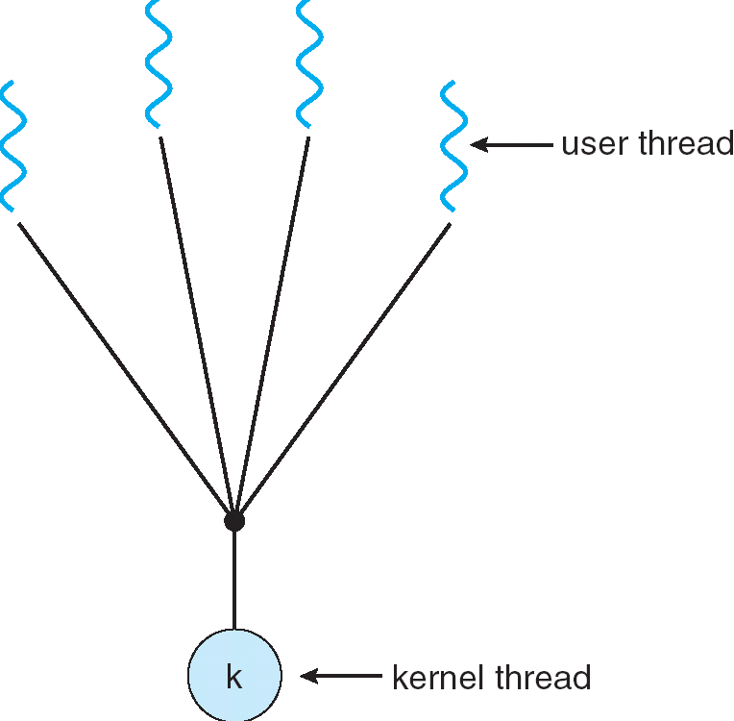
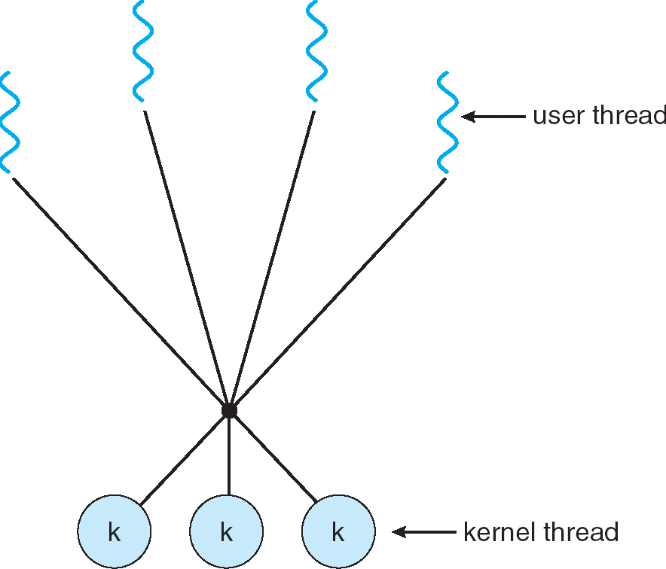
How expensive is context switching?
Switching between threads in same process similar to switching between threads in different processes, but much cheaper:
No need to change address space
Some numbers from Linux:
Frequency of context switch: 10-100ms
Switching between processes: 3-4 μsec.
Switching between threads: 100 ns
Even cheaper: switch threads (using “yield”) in user-space!
What we are talking about in Today’s lecture
Simple One-to-One
Threading Model
Many-to-One
Many-to-Many

Slide 11
What happens when thread blocks on I/O?
CopyFile
read
Trap to OS
Stack growth
kernel_read
run_new_thread
switch
What happens when a thread requests a block of data from the file system?
User code invokes a system call
Read operation is initiated
Run new thread/switch
Thread communication similar
Wait for Signal/Join
Networking

Slide 12
External Events
What happens if thread never does any I/O, never waits, and never yields control?
Could the ComputePI program grab all resources and never release the processor?
What if it didn’t print to console?
Must find way that dispatcher can regain control!
Answer: utilize external events
Interrupts: signals from hardware or software that stop the running code and jump to kernel
Timer: like an alarm clock that goes off every some milliseconds
If we make sure that external events occur frequently enough, can ensure dispatcher runs
Notes:
Patterson’s a nice guy, so he gives up the body after using it for awhile and let’s John Kubitowicz have it.
But Kubi’s not so nice, so he won’t give up control…
If you want to wake up for a final, you set your clock, or ask your roommate to pour water over your head – OS does the same

Slide 13
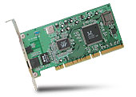
Recall: Interrupt Controller
Interrupt Mask
Priority Encoder
IntID
CPU
Interrupt
Int Disable
Timer
Software
Interrupt
Control
NMI
Network
Interrupts invoked with interrupt lines from devices
Interrupt controller chooses interrupt request to honor
Interrupt identity specified with ID line
Mask enables/disables interrupts
Priority encoder picks highest enabled interrupt
Software Interrupt Set/Cleared by Software
CPU can disable all interrupts with internal flag
Non-Maskable Interrupt line (NMI) can’t be disabled

Slide 14
Example: Network Interrupt
Raise priority
(set mask)
Reenable All Ints
Save registers
Dispatch to Handler
…
Transfer Network Packet from hardware to Kernel Buffers
…
Restore registers
Clear current Int
Disable All Ints
Restore priority
(clear Mask)
RTI
...
add $r1,$r2,$r3
subi $r4,$r1,#4
slli $r4,$r4,#2
...
PC saved
Disable All Ints
Kernel Mode
External Interrupt
Pipeline Flush
“Interrupt Handler”
...
lw $r2,0($r4)
lw $r3,4($r4)
add $r2,$r2,$r3
sw 8($r4),$r2
...
Restore PC
Enable all Ints
User Mode
An interrupt is a hardware-invoked context switch
No separate step to choose what to run next
Always run the interrupt handler immediately

Slide 15
Use of Timer Interrupt to Return Control
Solution to our dispatcher problem
Use the timer interrupt to force scheduling decisions
Timer Interrupt routine:
TimerInterrupt() { DoPeriodicHouseKeeping(); run_new_thread(); }
Some Routine
Interrupt
TimerInterrupt
Stack growth
run_new_thread
switch

Slide 16
ThreadFork(): Create a New Thread
ThreadFork() is a user-level procedure that creates a new thread and places it on ready queue
Arguments to ThreadFork()
Pointer to application routine (fcnPtr)
Pointer to array of arguments (fcnArgPtr)
Size of stack to allocate
Implementation
Sanity check arguments
Enter Kernel-mode and Sanity Check arguments again
Allocate new Stack and TCB
Initialize TCB and place on ready list (Runnable)

Slide 17
How do we initialize TCB and Stack?
Initialize Register fields of TCB
Stack pointer made to point at stack
PC return address ⇒ OS (asm) routine ThreadRoot()
Two arg registers (a0 and a1) initialized to fcnPtr and fcnArgPtr, respectively
Initialize stack data?
Minimal initialization ⇒setup return to go to beginning of ThreadRoot()
Important part of stack frame is in registers for RISC-V (ra)
X86: need to push a return address on stack
Think of stack frame as just before body of ThreadRoot() really gets started
ThreadRoot stub
Stack growth
Initial Stack

Slide 18
How does Thread get started?
Other Thread
ThreadRoot
A
B(while)
Stack growth
yield
kernel_yield
run_new_thread
New Thread
switch
ThreadRoot stub
Eventually, run_new_thread() will select this TCB and return into beginning of ThreadRoot()
This really starts the new thread

Slide 19
How does a thread get started?
Other Thread
SetupNewThread(tNew) {
…
TCB[tNew].regs.sp = newStackPtr;
TCB[tNew].regs.retpc = &ThreadRoot;
TCB[tNew].regs.r0 = fcnPtr TCB[tNew].regs.r1 = fcnArgPtr
}
ThreadRoot
A
B(while)
Stack growth
yield
kernel_yield
run_new_thread
New Thread
switch
ThreadRoot stub
How do we make a new thread?
Setup TCB/kernel thread to point at new user stack and ThreadRoot code
Put pointers to start function and args in registers or top of stack
This depends heavily on the calling convention (i.e. RISC-V vs x86)
Eventually, run_new_thread() will select this TCB and return into beginning of ThreadRoot()
This really starts the new thread

Slide 20
What does ThreadRoot() look like?
ThreadRoot() is the root for the thread routine:
ThreadRoot(fcnPTR,fcnArgPtr) {
DoStartupHousekeeping();
UserModeSwitch(); /* enter user mode */
Call fcnPtr(fcnArgPtr);
ThreadFinish();
}
Startup Housekeeping
Includes things like recording start time of thread
Other statistics
Stack will grow and shrink with execution of thread
Final return from thread returns into ThreadRoot() which calls ThreadFinish()
ThreadFinish() wake up sleeping threads
ThreadRoot
Thread Code *fcnPtr()
Stack growth
Running Stack

Slide 21
Threads vs Address Spaces: Options
One
Many
# of addr spaces:
# threads
Per AS:
One
MS/DOS, early Macintosh
Traditional UNIX
Many
Embedded systems (Geoworks, VxWorks, JavaOS,etc)
JavaOS, Pilot(PC)
Mach, OS/2, Linux
Windows 10
Win NT to XP, Solaris, HP-UX, OS X
Most operating systems have either
One or many address spaces
One or many threads per address space

Slide 22
Administrivia
Midterm Thursday 2/15
Closed book, but one page of handwritten notes, both sides
No class on day of midterm
8-10PM
Project 1 Design Document due next Saturday 2/10
No extensions of any sort on design documents!!!
Project 1 Design reviews upcoming
High-level discussion of your approach
What will you modify?
What algorithm will you use?
How will things be linked together, etc.
Do not need final design (complete with all semicolons!)
You will be asked about testing
Understand testing framework
Are there things you are doing that are not tested by tests we give you?
Do your own work!
Please do not try to find solutions from previous terms
We will be on the look out for anyone doing this…today

Slide 23
Goals for Rest of Today
Challenges and Pitfalls of Concurrency
Synchronization Operations/Critical Sections
How to build a lock?
Atomic Operations

Slide 24
Concurrency vs Parallelism
Multithreading: Multiple threads per Process (A programming strategy)
Multiplexing: Sharing a single resource (such as a core) among multiple threads
What does it mean to run two threads “concurrently” (regardless of process)?
Scheduler is free to run threads in any order and interleaving: FIFO, Random, …
Unless synchronization is involved, multiple threads are concurrent!
Assume: if scheduler can produce the worst possible interleaving, IT WILL!
What does it mean to run two threads “in parallel” (regardless of process)?
Threads are actually running at the same time
Parallel ⇒ Concurrent but Concurrent ⇏ Parallel
A
B
C
Concurrent examples
(Not parallel)
A
B
C
A
B
C
B
A
Parallel and Concurrent (Multiprocessing)
B
C

Slide 25
ATM Bank Server
ATM server problem:
Service a set of requests
Do so without corrupting database
Don’t hand out too much money

Slide 26
ATM bank server example
Suppose we wanted to implement a server process to handle requests from an ATM network:
BankServer() { while (TRUE) { ReceiveRequest(&op, &acctId, &amount); ProcessRequest(op, acctId, amount); } }
ProcessRequest(op, acctId, amount) { if (op == deposit) Deposit(acctId, amount); else if … }
Deposit(acctId, amount) { acct = GetAccount(acctId); /* may use disk I/O */ acct->balance += amount; StoreAccount(acct); /* Involves disk I/O */ }
How could we speed this up?
More than one request being processed at once
Event driven (overlap computation and I/O)
Multiple threads (multi-proc, or overlap comp and I/O)

Slide 27
Event Driven Version of ATM server
Suppose we only had one CPU
Still like to overlap I/O with computation
Without threads, we would have to rewrite in event-driven style
Example
BankServer() { while(TRUE) { event = WaitForNextEvent(); if (event == ATMRequest) StartOnRequest(); else if (event == AcctAvail) ContinueRequest(); else if (event == AcctStored) FinishRequest(); } }
This technique is used for graphical programming
Complication:
What if we missed a blocking I/O step?
What if we have to split code into hundreds of pieces which could be blocking?

Slide 28
Can Threads (in same Process) Make This Easier?
Threads yield overlapped I/O and computation without “deconstructing” code into non-blocking fragments
One thread per request
Requests proceeds to completion, blocking as required:
Deposit(acctId, amount) { acct = GetAccount(actId); /* May use disk I/O */ acct->balance += amount; StoreAccount(acct); /* Involves disk I/O */ }
Unfortunately, shared state can get corrupted: Thread 1 Thread 2 load r1, acct->balance load r1, acct->balance add r1, amount2 store r1, acct->balance add r1, amount1 store r1, acct->balance

Slide 29
Problem is at the Lowest Level
Most of the time, threads are working on separate data, so scheduling doesn’t matter:
Thread A Thread B
x = 1; y = 2;
However, what about (Initially, y = 12):
Thread A Thread B
x = 1; y = 2;
x = y+1; y = y*2;
What are the possible values of x?
Or, what are the possible values of x below?
Thread A Thread B
x = 1; x = 2;
X could be 1 or 2 (non-deterministic!)
Could even be 3 for serial processors:
Thread A writes 0001, B writes 0010 → scheduling order ABABABBA yields 3!
Notes:
X could be (13, 5, 3)

Slide 30
Atomic Operations
To understand a concurrent program, we need to know what the underlying indivisible operations are!
Atomic Operation: an operation that always runs to completion or not at all
It is indivisible: it cannot be stopped in the middle and state cannot be modified by someone else in the middle
Fundamental building block – if no atomic operations, then have no way for threads to work together
On most machines, memory references and assignments (i.e. loads and stores) of words are atomic
Consequently – weird example that produces “3” on previous slide can’t happen
Many instructions are not atomic
Double-precision floating point store often not atomic
VAX and IBM 360 had an instruction to copy a whole array

Slide 31
Another Concurrent Program Example
Two threads, A and B, compete with each other
One tries to increment a shared counter
The other tries to decrement the counter
Thread A Thread B
i = 0; i = 0; while (i < 10) while (i > -10) i = i + 1; i = i – 1; printf(“A wins!”); printf(“B wins!”);
Assume that memory loads and stores are atomic, but incrementing and decrementing are not atomic
Who wins? Could be either
Is it guaranteed that someone wins? Why or why not?
What if both threads have their own CPU running at same speed? Is it guaranteed that it goes on forever?

Slide 32
Hand Simulation Multiprocessor Example
Inner loop looks like this:
Thread A Thread B
r1=0 load r1, M[i]
r1=0 load r1, M[i]
r1=1 add r1, r1, 1
r1=-1 sub r1, r1, 1
M[i]=1 store r1, M[i]
M[i]=-1 store r1, M[i]
Hand Simulation:
And we’re off. A gets off to an early start
B says “hmph, better go fast” and tries really hard
A goes ahead and writes “1”
B goes and writes “-1”
A says “HUH??? I could have sworn I put a 1 there”
Could this happen on a uniprocessor? With Hyperthreads?
Yes! Unlikely, but if you are depending on it not happening, it will and your system will break…

Slide 33
Definitions
Synchronization: using atomic operations to ensure cooperation between threads
For now, only loads and stores are atomic
We are going to show that its hard to build anything useful with only reads and writes
Mutual Exclusion: ensuring that only one thread does a particular thing at a time
One thread excludes the other while doing its task
Critical Section: piece of code that only one thread can execute at once. Only one thread at a time will get into this section of code
Critical section is the result of mutual exclusion
Critical section and mutual exclusion are two ways of describing the same thing

Slide 34
Locks
Lock: prevents someone from doing something
Lock() before entering critical section and before accessing shared data
Unlock() when leaving, after accessing shared data
Wait if locked
Important idea: all synchronization involves waiting
Locks need to be allocated and initialized:
structure Lock mylock or pthread_mutex_t mylock;
lock_init(&mylock) or mylock = PTHREAD_MUTEX_INITIALIZER;
Locks provide two atomic operations:
acquire(&mylock) – wait until lock is free; then mark it as busy
After this returns, we say the calling thread holds the lock
release(&mylock) – mark lock as free
Should only be called by a thread that currently holds the lock
After this returns, the calling thread no longer holds the lock

Slide 35
Fix banking problem with Locks!
Identify critical sections (atomic instruction sequences) and add locking:
Deposit(acctId, amount) {
acquire(&mylock) // Wait if someone else in critical section! acct = GetAccount(actId); acct->balance += amount; StoreAccount(acct);
release(&mylock) // Release someone into critical section }
Must use SAME lock (mylock) with all of the methods (Withdraw, etc…)
Shared with all threads!
Critical Section
Thread B
Thread A
Thread C
Threads serialized by lock through critical section.
Only one thread at a time
acquire(&mylock)
Thread C
Critical Section
Thread B
Thread A
release(&mylock)
Thread A
Thread B

Slide 36
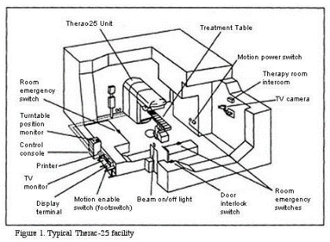
Correctness Requirements
Threaded programs must work for all interleavings of thread instruction sequences
Cooperating threads inherently non-deterministic and non-reproducible
Really hard to debug unless carefully designed!
Example: Therac-25
Machine for radiation therapy
Software control of electron accelerator and electron beam/ Xray production
Software control of dosage
Software errors caused the death of several patients
A series of race conditions on shared variables and poor software design
“They determined that data entry speed during editing was the key factor in producing the error condition: If the prescription data was edited at a fast pace, the overdose occurred.”

Slide 37
Conclusion
Every thread has both a user and kernel stack
Showed more details about context-switching mechanisms
Concurrent threads introduce problems when accessing shared data
Programs must be insensitive to arbitrary interleavings
Without careful design, shared variables can become completely inconsistent
Important concept: Atomic Operations
An operation that runs to completion or not at all
These are the primitives on which to construct various synchronization primitives
Introduced the Lock API: acquire() and release()
Next time: How do we make a lock?

